Slide 1
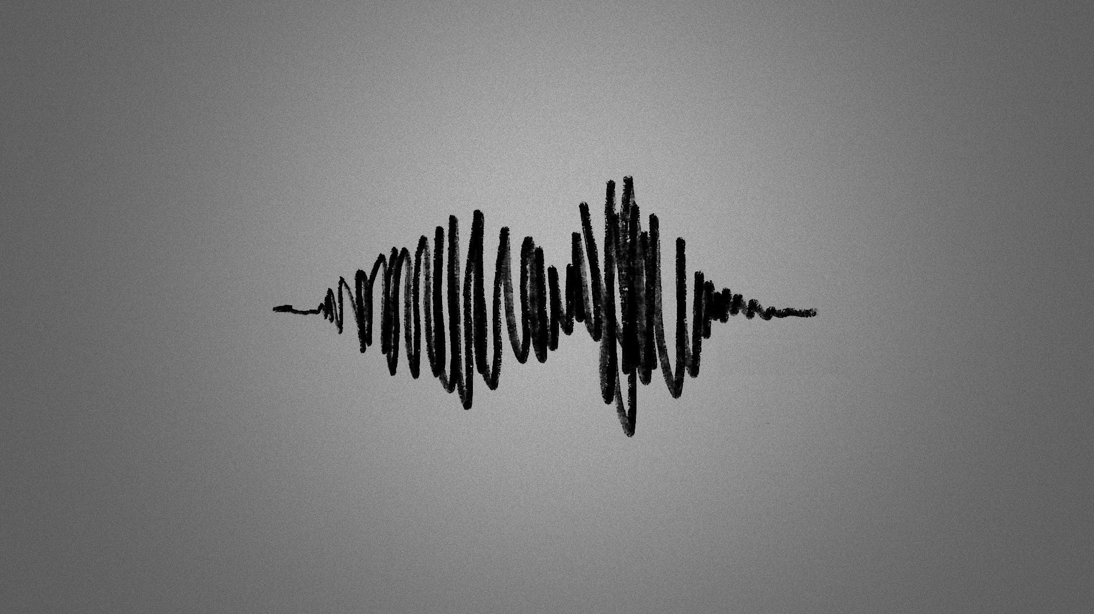
Speaker Recognition
september Project presentation
By Ali Farazdaqi and Amir Safizadeh

Slide 2

Sample of Speaker Recognition
What is Speaker Recognition
Features of our program
Question
1

Slide 3

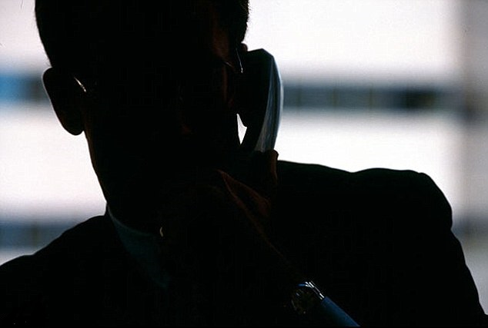
SECURITY Phone Call
You are able to provide your
SECURITY with Speaker Recognition on the phone
This way you’ll never robbed or something like that
2

Slide 4

WHAT is Speaker Recognition?
Speaker recognition is
the identification of a person from characteristics of voices (voice biometrics)
NOT MATCH
3

Slide 5


Features
Unlimited number of users
Accuracy of detection
Low memory footprint
Coded with C
User friendly
CPU usage
Portable
4

Slide 6

Unlimited Number of users
5

Slide 7


Accuracy of detection
6

Slide 8

Low memory footprint
It is only use Maximum 50MB of memory
94%
7

Slide 9

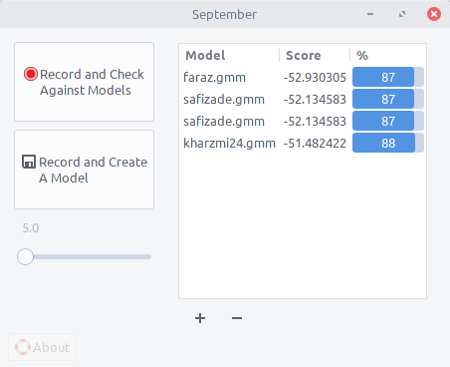
User Friendly
Easy for users to use the program and tools + GRAPHICAL
The iteration we used
8

Slide 10




Portable
MAC
Windows
Linux
9Features

Slide 11

CPU usage
Use minimum usage of CPU
10

Slide 12
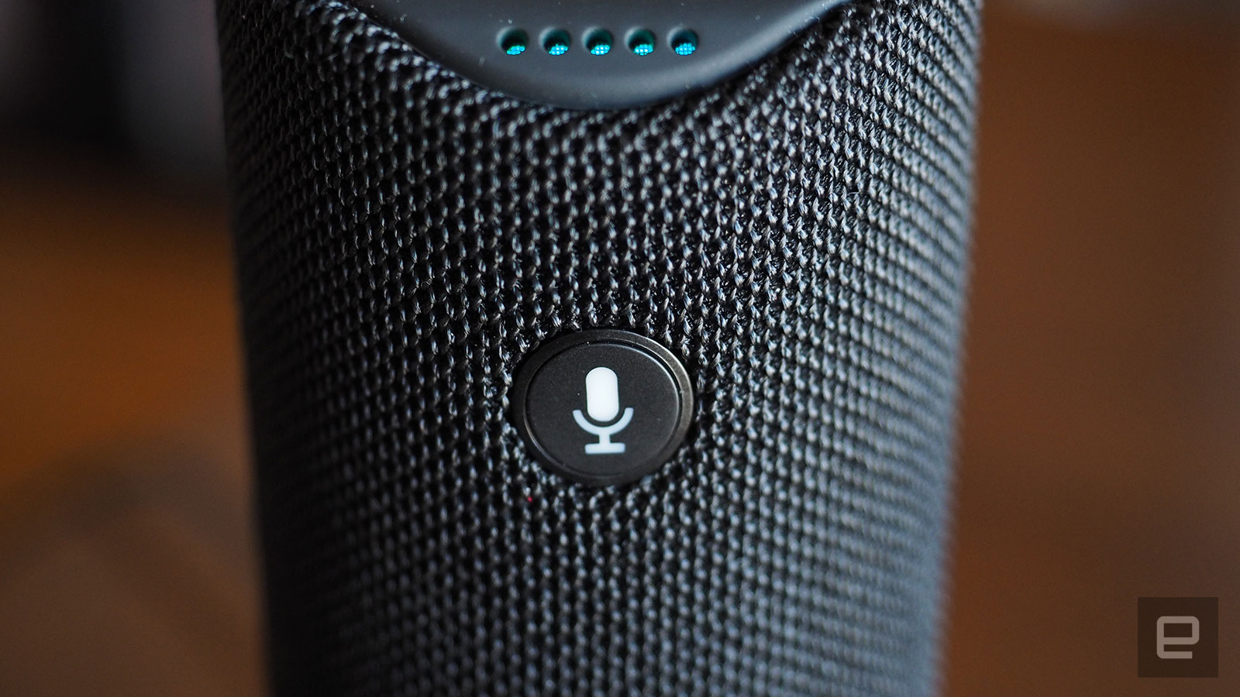

Coded
With
11

Slide 13
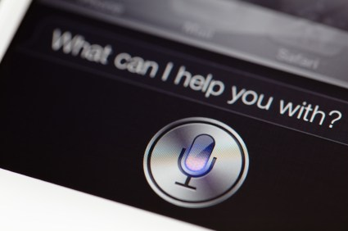
We can
help
you
12

Slide 14
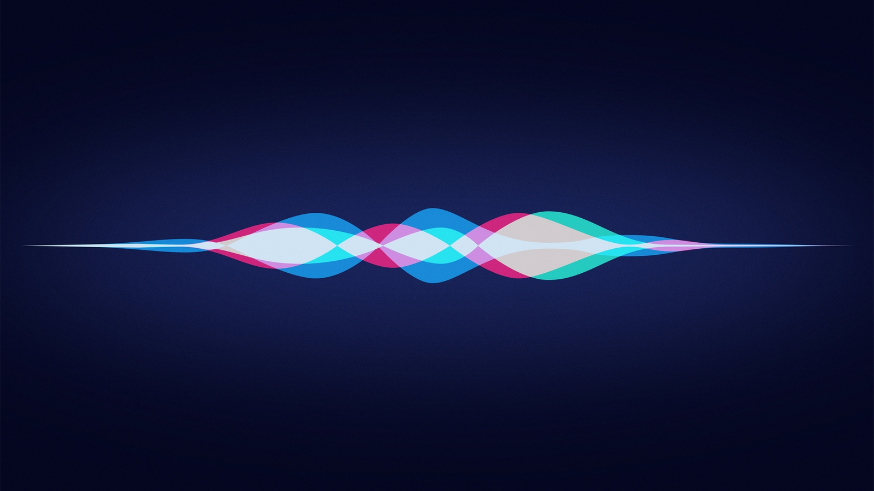

Any Question?

